Slide 1

Vel Tech Rangarajan Dr. Sagunthala R&D Institute of Science and Technology
School of Computing
Department of Computer Science and Engineering
10211CS224 / FULL STACK APPLICATION DEVELOPMENT (JAVA)
PROJECT REVIEW : MILESTONE PROJECT
Date: 06-05-2026
Job Portal Management System
Presented By:
B.VISHNU VARDHAN– VTU24685 – 23UECS1020
Courses Handling Faculty:
Dr. HAFIZUR RAHAMAN
Assistant professor

Slide 2
INTRODUCTION
1
A Job Portal Management System is a web-based application designed to connect job seekers and employers.
It provides a centralized platform for managing job postings and applications efficiently. Users can create profiles, upload resumes, and search for jobs based on various criteria.
Employers can post job vacancies and review applications from candidates.
The system simplifies the recruitment process by automating manual tasks. It helps in reducing time and effort involved in hiring and job searching.
The platform supports filtering jobs by location, skills, and experience. It also allows tracking of application status in real time.
With secure login features, user data is protected and managed effectively.
Overall, the system enhances communication between employers and job seekers.
2
3
4
5
6
7
8
9

Slide 3
PROBLEM STATEMENT
In traditional job recruitment systems, most processes are manual and inefficient. Job seekers often struggle to find relevant job opportunities in one place.
Employers face difficulties in managing a large number of applications. There is no centralized system to store and track job-related data. Manual handling of resumes leads to delays and errors.
Communication between employers and candidates is often slow and unclear. Applicants do not receive timely updates about their application status.
Searching for jobs based on skills, location, or experience is limited. Recruiters spend more time sorting and filtering candidates manually. Existing systems lack automation and real-time updates.
Data management becomes complex as the number of users increases. There is a risk of data loss and duplication in manual systems.
Security of user information is often not properly maintained. The absence of a user-friendly interface reduces system usability.
Therefore, there is a need for an efficient, automated Job Portal Management System.
1
2
3
4
5
6
7
8
9

Slide 4
OBJECTIVE(S)
Here are clear Objectives for your Job Portal Management System:
Objectives:
To develop a web-based platform that connects job seekers and employers.
To provide user registration and secure login functionality.
To enable job seekers to create profiles and upload resumes.
To allow users to search and filter jobs based on skills, location, and experience.
To enable employers to post, update, and delete job listings.
To provide an easy way for candidates to apply for jobs online.
To allow employers to view and manage job applications.
To implement application tracking for job seekers.
To ensure secure handling of user data with proper authentication.
To reduce manual effort and improve efficiency in the recruitment process.
1
2
3
4
5
6
7
8
9

Slide 5
PROPOSED SYSTEM
1
The proposed system is a web-based Job Portal Management System designed to simplify the recruitment process. It provides a centralized platform where job seekers and employers can interact efficiently.
Users can register, create profiles, and upload resumes through a user-friendly interface. Job seekers can search and apply for jobs based on their skills, location, and experience.
Employers can post job openings, update details, and manage applications easily. The system stores all data in a centralized database for quick access and management.
It allows real-time tracking of job applications and their status. The platform includes secure login and role-based access for users and employers.
Automation reduces manual effort and minimizes errors in recruitment. The system improves communication between candidates and employers. Overall, it enhances efficiency, accuracy, and user experience in job management.
2
3
4
5
6
7
8
9

Slide 6
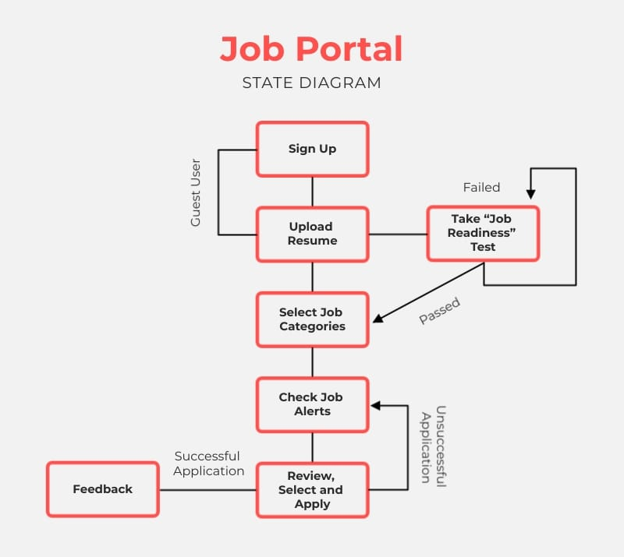
Here is a clear Proposed System Architecture (10–12 lines) for your Job Portal Management System:
Proposed System Architecture:
The Job Portal Management System follows a multi-layered architecture. The process begins with the user accessing the system through a web browser.
The frontend is developed using HTML, CSS, JavaScript, and Thymeleaf to provide an interactive interface.
User requests are sent to the backend through HTTP requests. The Controller layer in Spring Boot handles incoming requests and directs them to the appropriate services.
The Service layer processes the business logic such as job posting and application handling.
The Repository layer interacts with the database using Spring Data JPA. The database (MySQL) stores all data including users, jobs, and applications. Spring Security is used to manage authentication and authorization.
Data flows between layers in a structured and secure manner. The system ensures efficient communication between frontend and backend. This architecture provides scalability, maintainability, and high performance.
PROPOSED SYSTEM ARCHITECTURE
1
2
3
4
5
6
7
8
9

Slide 7
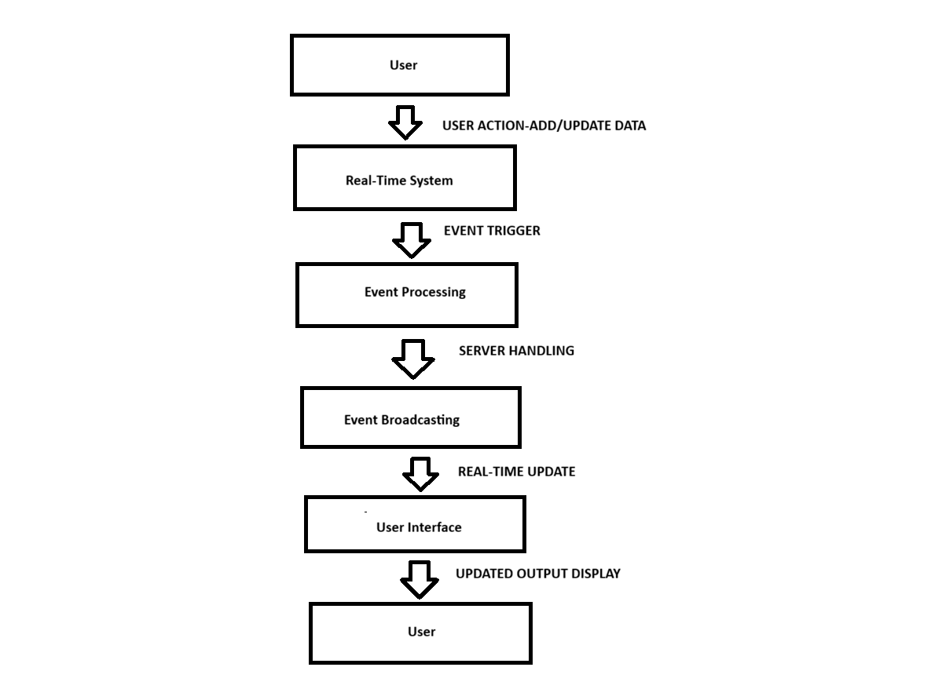
WORKFLOW
1
The Data Flow Diagram shows how data moves in the Real-Time Event Synchronization Engine.
The user performs an action, which is sent to the system through a WebSocket connection.
The server processes the event and broadcasts it to all connected clients. The updated data is displayed instantly on all user interfaces. This ensures real-time synchronization without page refresh.
2
3
4
5
6
7
8
9

Slide 8
TECHNOLOGIES USED
Frontend:
HTML5 – Used for structuring web pages
CSS3 – Used for styling and layout design
JavaScript – Used for interactivity and dynamic behavior
Thymeleaf – Template engine for integrating frontend with backend
Backend:
Spring Boot – Main framework for building the application
Spring MVC – Handles request routing and application flow
Spring Data JPA – Manages database operations using ORM
Database:
MySQL – Stores user, job, and application data
Security:
Spring Security – Provides authentication and role-based authorization
BCrypt – Used for password encryption
Tools & Environment:
IntelliJ IDEA / VS Code – Code development
Maven – Dependency management
Web Browser (Chrome/Edge) – Application testing
1
2
3
4
5
6
7
8
9

Slide 9
MODULE DESCRIPTION
Module 1: User Management Module
This module handles user registration and login functionality. It allows job seekers and employers to create accounts and maintain their profiles. Users can update personal details such as name, email, and password. Authentication and role-based access are also managed in this module.
Module 2: Job Management Module
This module allows employers to post new job vacancies with details like title, skills, salary, and location. Employers can edit or delete job postings as needed. Job listings are displayed to users in an organized manner. It ensures proper management of all job-related data.
Module 3: Job Search & Filter Module
This module enables job seekers to search for jobs based on criteria such as skills, location, and experience. It provides filtering options to quickly find relevant job opportunities. The system improves user experience by displaying accurate and sorted results.
Module 4: Application Management Module
This module allows users to apply for jobs online. It stores application details such as user, job, and application status. Employers can view all applicants for their posted jobs. They can shortlist or reject candidates based on requirements.
1
2
3
4
5
6
7
8
9

Slide 10
MODULE DESCRIPTION
1
IIMPLEMENATION MODULE: EMAIL VERIFICATION :
The system implements Two-Factor Authentication (2FA) to provide an additional layer of security during user login. After entering the correct password, a unique 6-digit One-Time Password (OTP) is generated and sent to the user’s registered email address. The user must enter this OTP within a limited time period to verify their identity. This ensures that even if the password is compromised, unauthorized access is prevented. The OTP is valid for a short duration and can be used only once, enhancing security further. The system also includes features like auto-fill, resend OTP, and a countdown timer for better user experience. Overall, this approach significantly reduces the risk of hacking and improves account protection.
2
3
4
5
6
7
8
9

Slide 11

IMPLEMENTATION SCREENSHOTS
1
Home Page
The Home Page introduces job portal platform and provides basic information about the jobs
It includes a “Register Now” button that redirects users to the registration page to get information about jobs.
2
3
4
5
6
7
8
9

Slide 12
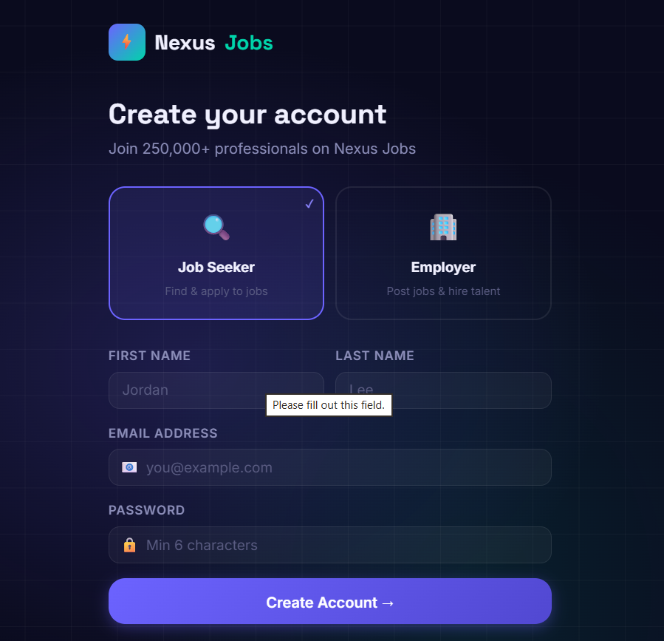
IMPLEMENTATION SCREENSHOTS
Login / Registration Page
The Registration Page allows users to enter their name and email and their role.
User details are validated and then forwaded to portal page.
1
2
3
4
5
6
7
8(A)
9

Slide 13
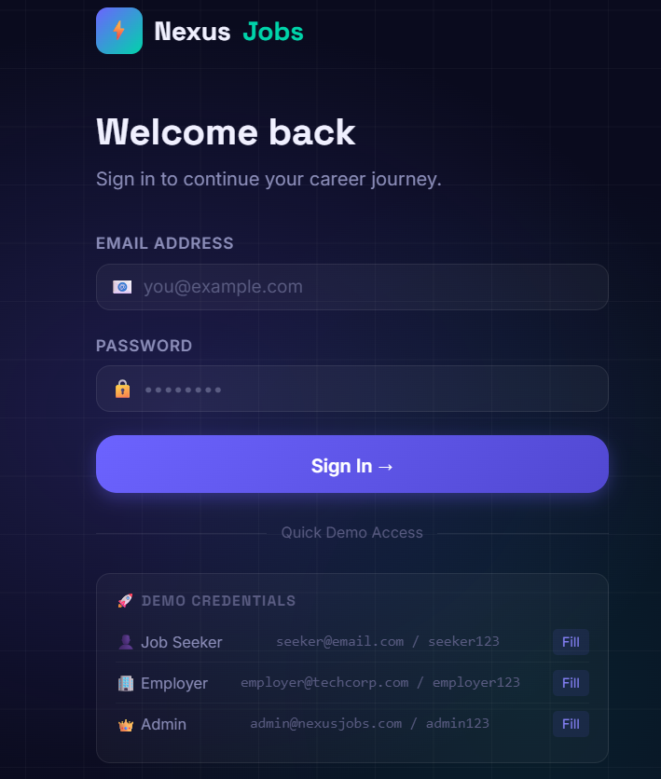
IMPLEMENTATION SCREENSHOTS
LOGIN PAGE
This module displays the login details along with “if u don’t have account we need to create new account”details.
Users can enter into main portal.
1
2
3
4
5
6
7
8(B)
9

Slide 14
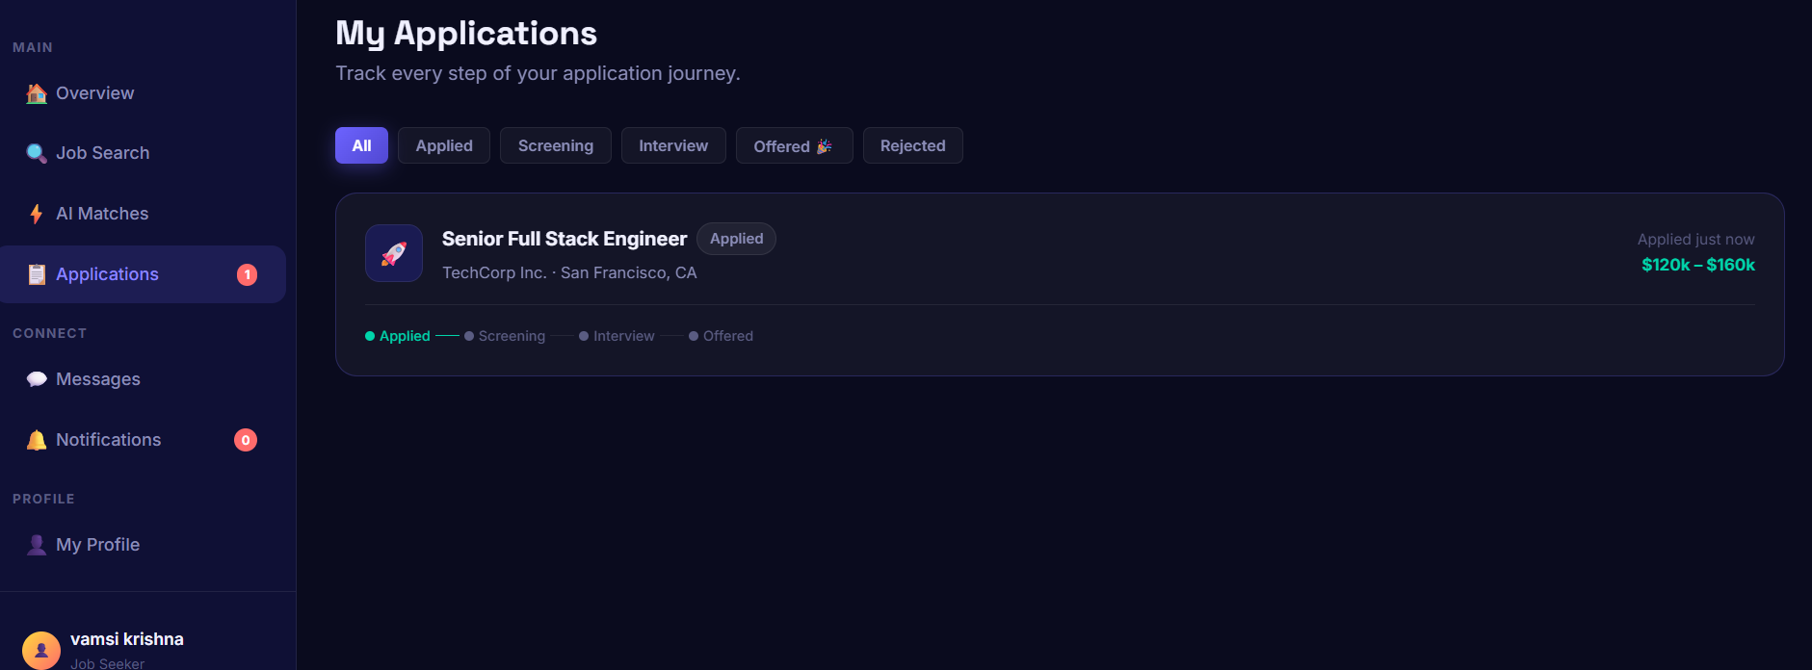
IMPLEMENTATION SCREENSHOTS
Output Page (Live Dashboard)
The Output Page displays whether we have received any emails about job offers.
If we have any offer letter ,we can also try to get a new job
1
2
3
4
5
6
7
8(C)
9

Slide 15
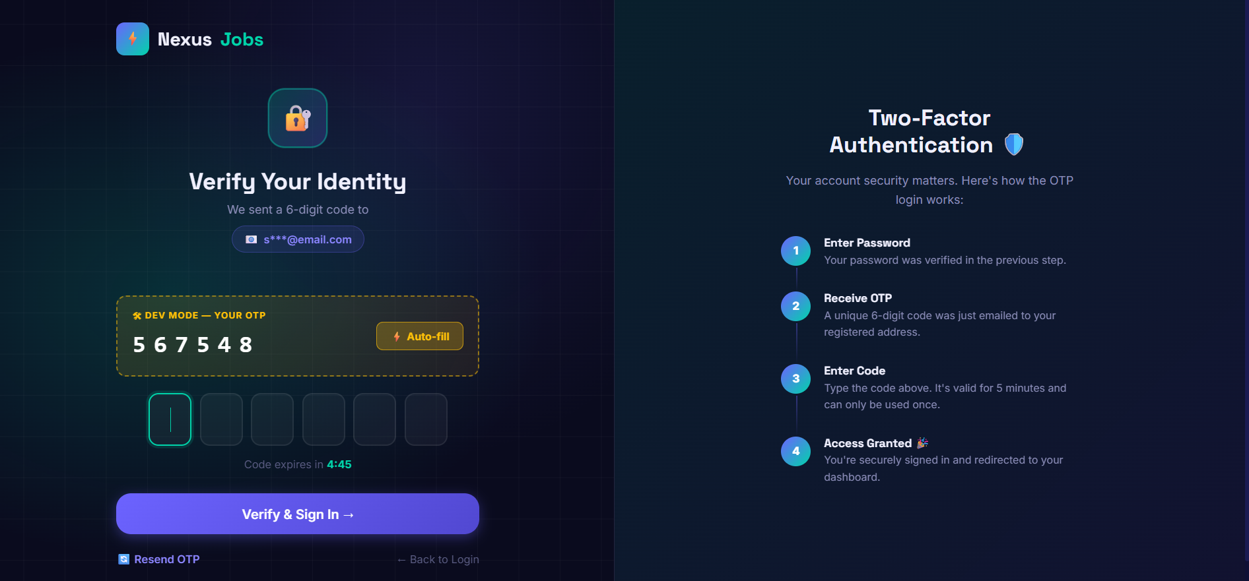
IMPLEMENTATION SCREENSHOTS
Authentication page:
The system uses Two-Factor Authentication (2FA) to enhance security.
A 6-digit One-Time Password (OTP) is sent to the user’s email.
The OTP must be entered within a limited time for verification.
1
2
3
4
5
6
7
8(C)
9

Slide 16
ADVANTAGES & LIMITATIONS
Advantages
Provides a centralized platform for job seekers and employers
Reduces manual effort in the recruitment process
Saves time for both applicants and recruiters
Easy job search with filters like location, skills, and experience
Enables quick and online job application submission
Real-time tracking of application status
Improves communication between candidates and employers
User-friendly interface for better usability
Secure data handling with authentication mechanisms
Scalable system that can handle multiple users
Limitations
Requires a stable internet connection to function properly
Basic security features may need further enhancement
Limited advanced analytics and reporting features
System performance may reduce with very high user load
Initial setup and maintenance require technical knowledge
Risk of data privacy issues if not properly secured
Limited personalization of job recommendations
Dependence on accurate user input data
Requires regular updates and maintenance
Not suitable for offline usage
1
2
3
4
5
6
7
8
9

Slide 17
Thank you

